Slide 1
Genetic Algorithm
Muneeb Ullah
F2020376037

Slide 2
Agenda
Description
Problem Statement
Code Walkthrough
Results
Analysis
References

Slide 3
Description
Genetic algorithms (gasoline) are optimization strategies inspired through the method of natural choice and genetics.
They belong to the class of evolutionary algorithms
They are extensively used to discover premiere solutions to complicated issues throughout various domains which includes engineering, economics, biology, and pc technology.
Used mostly for solving optimization problems.

Slide 4
Problem Statement
Knapsack Problem
In this problem, we are given a set of items, each with a weight and a value, and a knapsack with a maximum weight capacity. The goal is to determine the combination of items to include in the knapsack that maximizes the total value while keeping the total weight within the capacity of the knapsack.
0/1 Knapsack Problem: In this variation, each item can either be included in the knapsack or not (i.e., it's a binary decision).

Slide 5
Code Walkthrough
1. generate_genome(length: int) -> Genome
This function generates a random genome of binary digits (0s and 1s) with the specified length.
2. generate_population(size: int, genome_length: int) -> Population
This function generates a population of genomes with the specified size, where each genome has the specified length.
3. single_point_crossover(a: Genome, b: Genome) -> Tuple[Genome, Genome]
This function performs single-point crossover between two parent genomes a and b, producing two offspring genomes.

Slide 6
Code Walkthrough
4. mutation(genome: Genome, num: int = 1, probability: float = 0.5) -> Genome
This function introduces mutations into a genome by randomly flipping bits with a given probability.
5. population_fitness(population: Population, fitness_func: FitnessFunc) -> int
This function calculates the total fitness of the entire population by summing the fitness values of all genomes in the population.
6. selection_pair(population: Population, fitness_func: FitnessFunc) -> Population
This function selects a pair of parent genomes from the population based on their fitness values using the roulette wheel selection method.

Slide 7
Code Walkthrough
7. sort_population(population: Population, fitness_func: FitnessFunc) -> Population
This function sorts the population based on the fitness values of the genomes in descending order.
8. genome_to_string(genome: Genome) -> str
This function converts a genome (list of integers) into a string representation for printing purposes.

Slide 8
Code Walkthrough
9. print_stats(population: Population, generation_id: int, fitness_func: FitnessFunc)
This function prints statistics about the current population, including the average fitness, best and worst genomes, and the generation number.
10. run_evolution(...) -> Tuple[Population, int]
This function orchestrates the genetic algorithm evolution process. It iterates through generations, performing selection, crossover, and mutation to evolve the population towards an optimal solution.

Slide 9
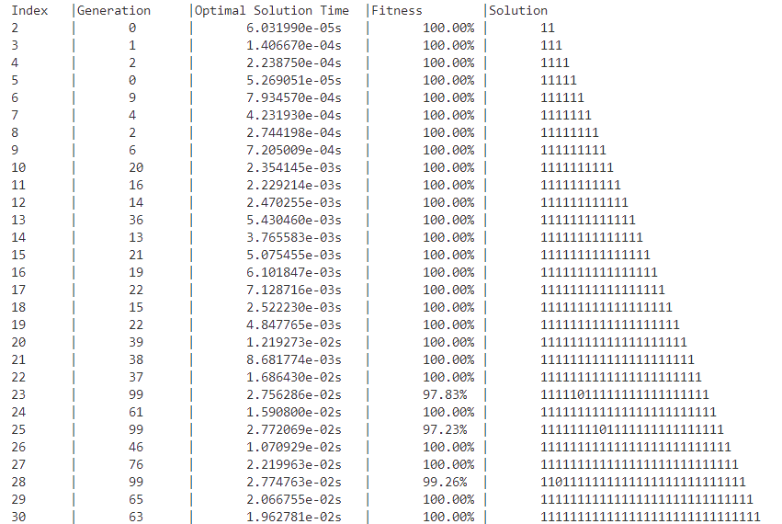
Results

Slide 10
Analysis
For smaller problem instances (e.g., 2-6 objects), the algorithm converges quickly within a few generations, achieving 100% fitness.
As the number of objects increases, the algorithm requires more generations to converge to the optimal solution. This is expected due to the increased complexity of the search space.
Despite the increasing complexity, the algorithm is still able to find optimal solutions within a reasonable time frame for larger problem instances (e.g., 10 objects), demonstrating its effectiveness in solving the knapsack problem.

Slide 11
References
Goldberg, D. E. (1989). Genetic Algorithms in Search, Optimization, and Machine Learning. Addison-Wesley.
Koza, J. R. (1992). Genetic programming: On the programming of computers by means of natural selection. MIT press.

